Slide 1
Titan Stock Price Analysis

Slide 2
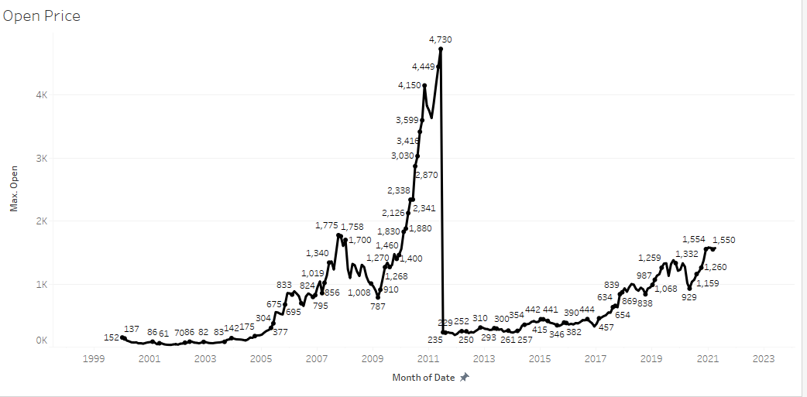
Opening Price Of Titan Stock
Highest opening price of the stock was 4730 which was on June 2011 .
Lowest opening price of the stock was 53 on October 2000 .
According to the current trend in March 2021 the last recorded opening price was 1550.

Slide 3
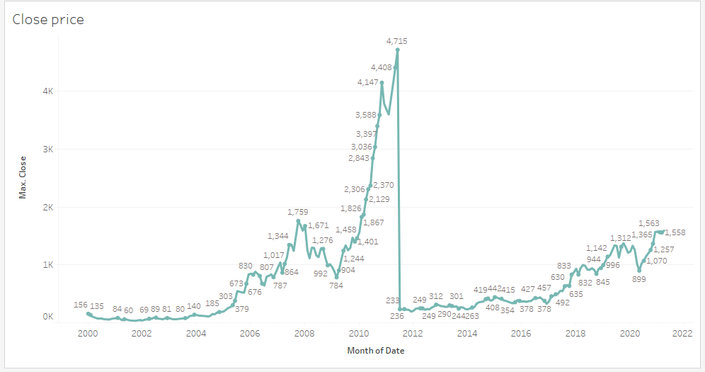
Closing Price Of Titan Stock
Highest Closing price of the stock was 4715 which was on June 2011 .
Lowest opening price of the stock was 54 on October 2000 .
According to the current trend in March 2021 the last recorded opening price was 1558.

Slide 4
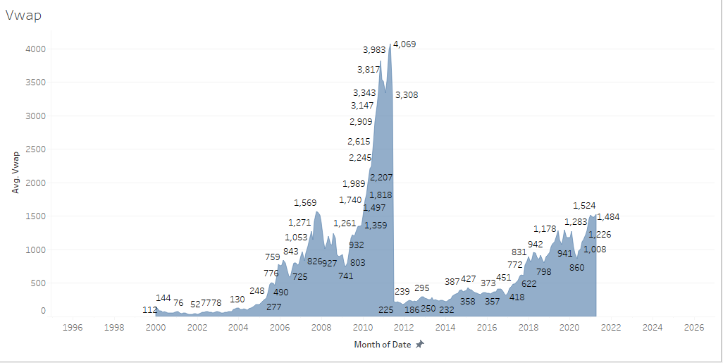
Average Price Of VWAP
The volume-weighted average price (VWAP) is a measurement that shows the average price of a security, adjusted for its volume.
Above can be seen that the average price a security has traded at throughout the day, based on volume and price

Slide 5
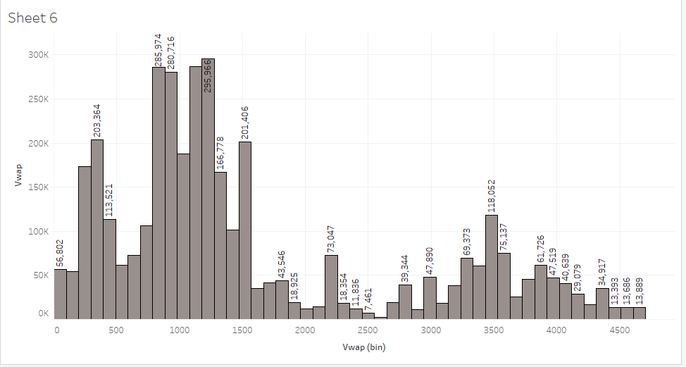
A histogram is a graph that represents the probability distribution of a dataset. The heights of the bars indicate the frequencies or probabilities for the different values.
Here the most observed price is around 550 and 1500. After that prices around 0 and 1500 hundreds are second most observed.

Slide 6
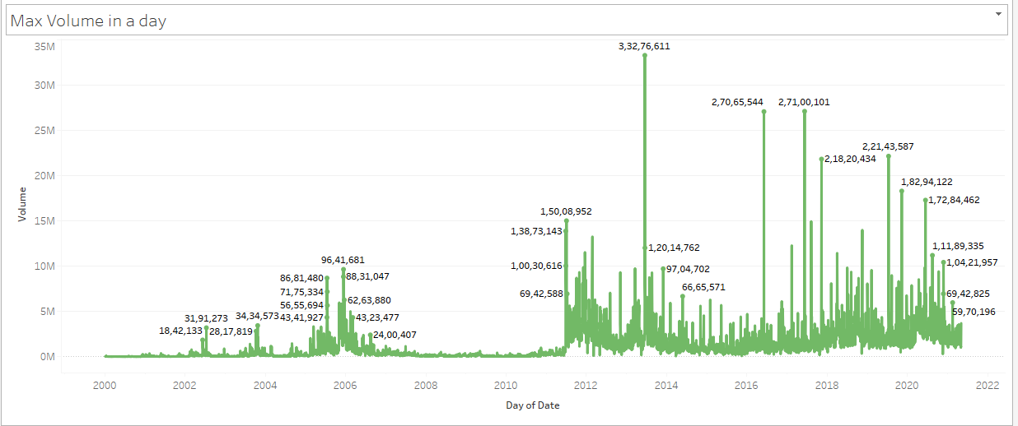
Maximum Volume in a Day
This chart shows the maximum volume traded in a day.
So according to the graph we can see that the maximum volume is 3,32,76,611 which was traded on 12th june 2013. The second highest was on 5th june 2017 2,71,00,101.

Slide 7
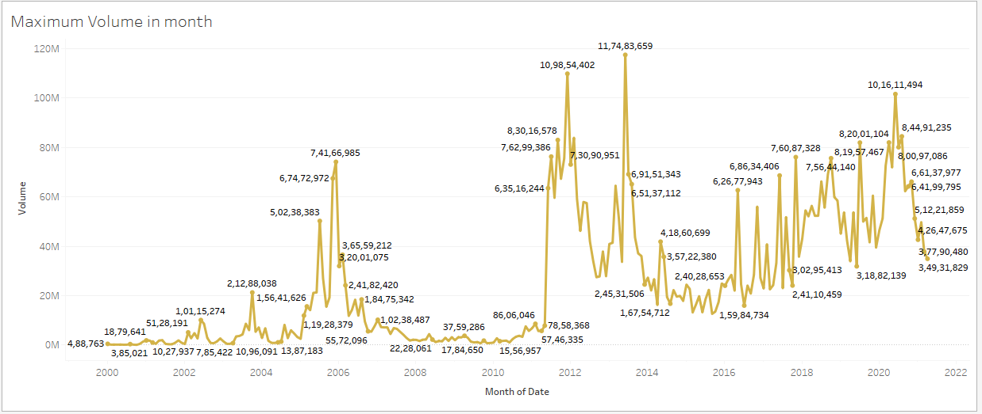
Maximum Volume in a Month
This chart shows the maximum volume traded in a month.
So according to the graph we can see that the maximum volume is 11,74,83,659 which was traded on june 2013. The second highest was on December 2017 10,98,54,402.

Slide 8
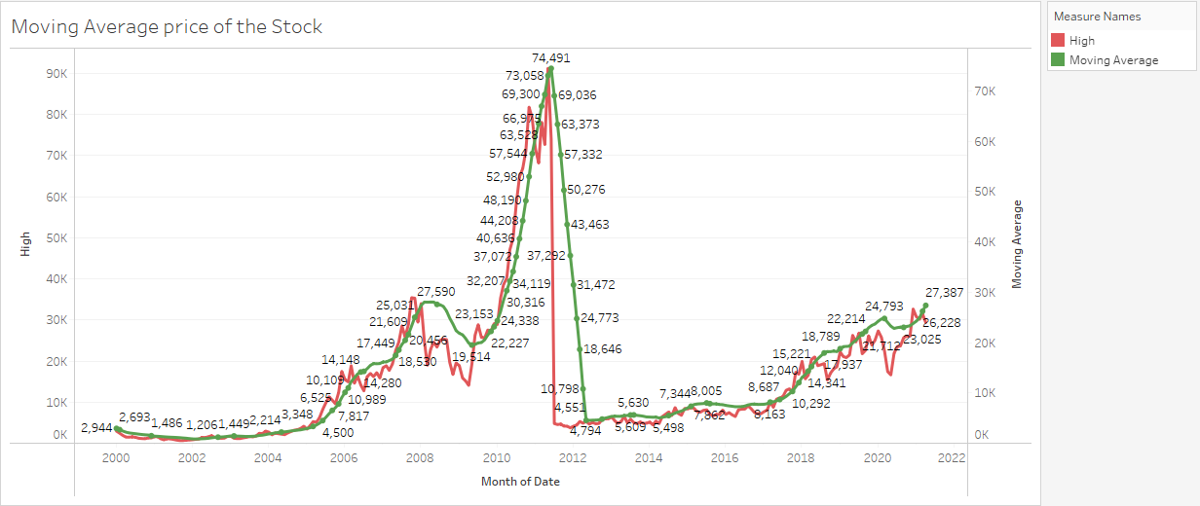
The above graph shows the moving average of the itan stock over the year 2000-2021
A moving average is a statistic that captures the average change in a data series over time.

Slide 9
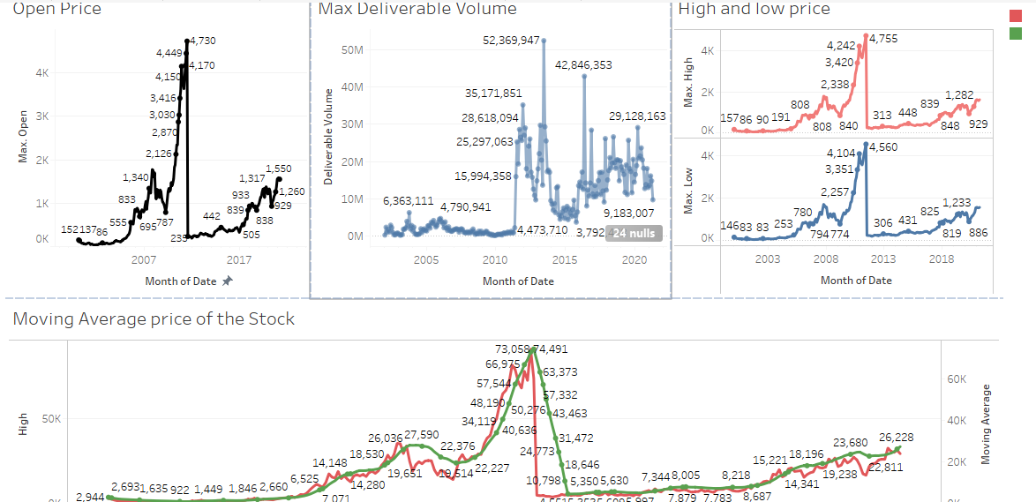
DASHBOARD 1

Slide 10
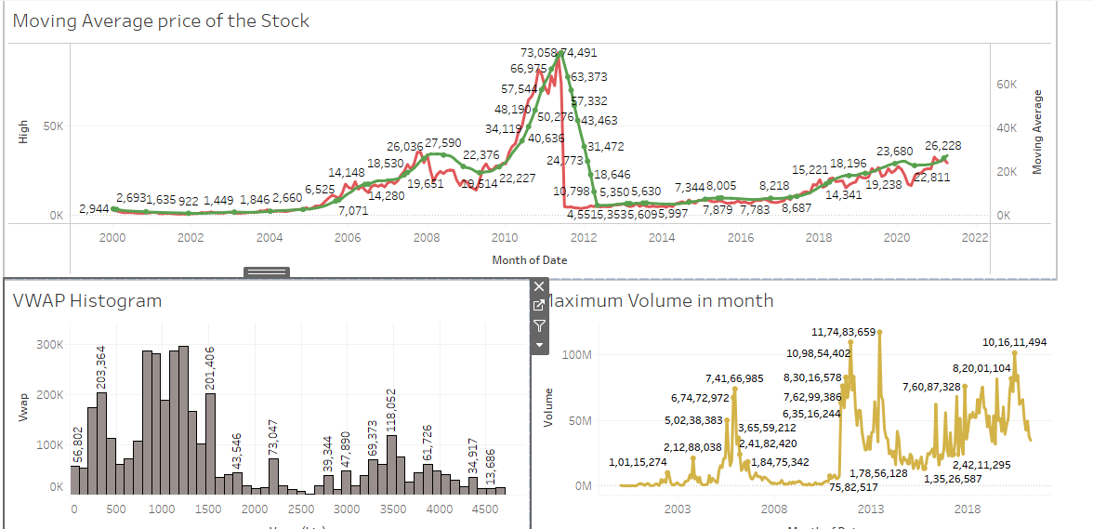
Dashboard 2

Slide 11
CONCLUSIUON
So, After the company faced a huge market crash in stock price in 2011, company is showing a stable growth in the price stock from 2011-2021 .
For the investors who wants to invest in Titan Stock It could be said that I would be a safe and good long term investment.
Titan has a strong foot in India and has got the trust of the citizens of India that is a valuable company. So overall it’s a good company with good stock price history.

